Slide 1
XtremeSense TMR Technology
TMR sensors and their applications
April 2024

Slide 2
TMR technology provides the highest accuracy, highest speed Magnetic Sensor ICs available in the market today
Hall Effect and TMR bring value to market
TMR technology to lead the high-performance Magnetic Sensing market of the future
Hall Effect Sensor
    Leading sensing technology with majority of market through 2030
    Most proven reliability over wide temperature ranges
Hall Effect
AMR
GMR
TMR
Tunneling Magneto-Resistive (TMR) Sensor
    TMR technology adoption significantly accelerating over 10-year horizon
    TMR technology results in 100 to 1000x larger signal than Hall, delivering greater accuracy and speed with lower power consumption
Accuracy
20x Higher Resolution at 5 MHz: TMR Current Sensors facilitate the GaN/SiC transition and make xEV/EVCI power electronics more efficient, with increased reliability
Speed
(GaN + SiC)
8x Higher Resolution at 40K RPM: TMR Angle Sensors provide extreme precision and heterogeneous redundancy in a small form factor for safety critical motor control systems (ADAS)
<1 uW power consumption: TMR Sensors enable ultra-low power for battery powered applications
Low Power

Slide 3



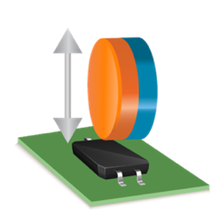
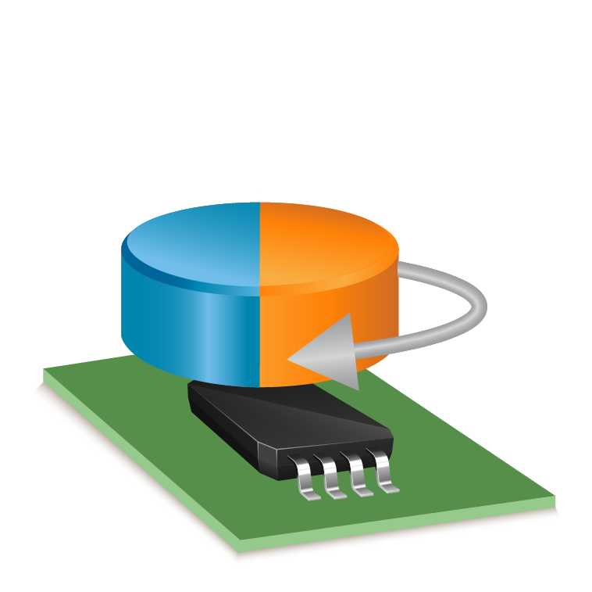

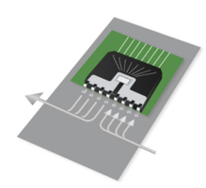


The Future of Sensing: XtremeSense TMR Technology
XtremeSense TMR technology delivers unprecedented performance breakthroughs in magnetic sensing
Highest sensitivity
Better SNR
Lowest power
Stable performance over temperature variations
XtremeSense
Current Sensor
XtremeSense
Switches/Latches
XtremeSense
Angle Sensors

Slide 4
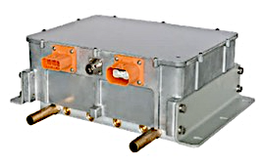
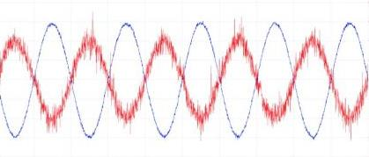
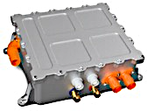
TMR preferred for Current Sensing in GaN and SiC Power Systems
Emerging preference for TMR Sensors in Coreless inverter applications as well
    Better (20x) signal to noise ratio at high speed (5 MHz) vs. Hall → more precise and efficient power control
    High speed Sensor ICs facilitate fast switching for protection of GaN and SiC → enhanced efficiency and reliability
    Results in smaller, lighter and higher efficiency power electronics systems
TMR ICs facilitate higher efficiency and smaller automotive on-board chargers and clean energy power systems
TMR Current Sensor
Hall Current Sensor
Waveform from https://www.embedded.com/tiny-sensors-benefit-current-sensing-applications/

Slide 5

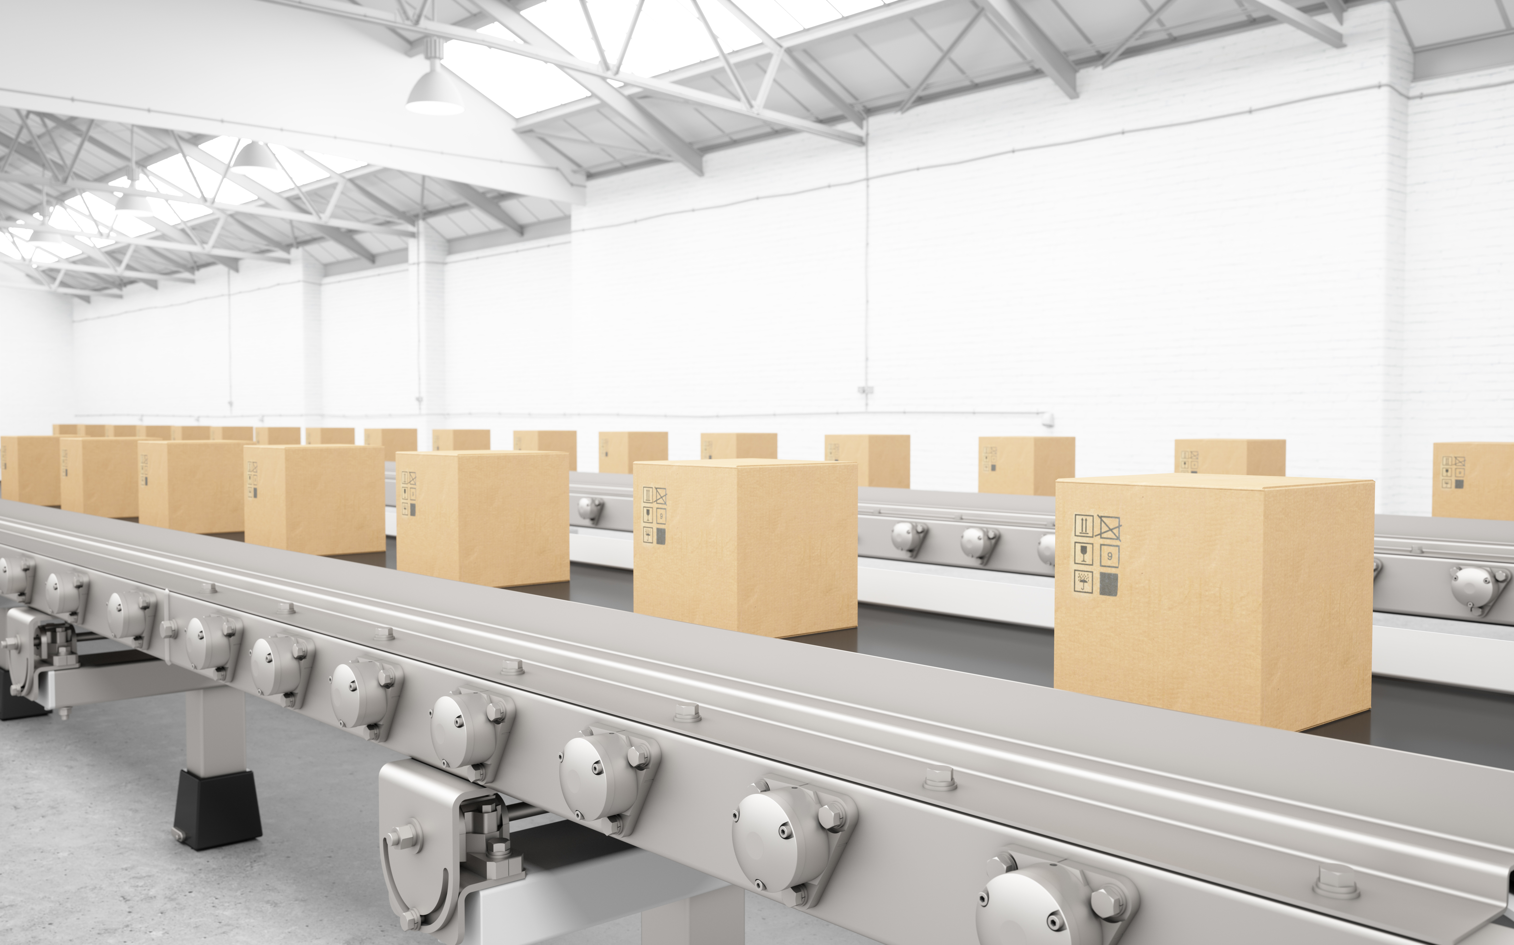

TMR Angle Sensors preferred for BLDC motor position control
    Better (8x) signal to noise ratio at high rotational speed (40K rpm) vs. Hall → more accurate and more efficient motor control
    TMR technology adds value across Industrial (Automation) motor applications
          Lower torque ripple / vibration, reduced audible noise, higher efficiency

Slide 6


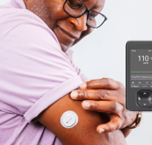
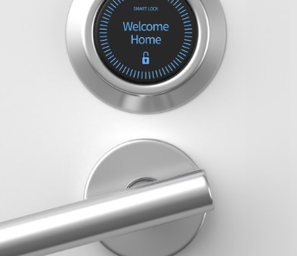

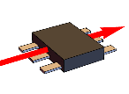
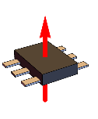
TMR Switches ideal for very low power applications
    Ultra low active power consumption for switches and latches (< 1 uW) ideal for battery operated applications
    Unique Z-axis TMR as “drop-in replacement” across legacy hall sensor applications requiring very low active power
Axis of magnetic sensitivity
Typical TMR
Traditional Hall
and Z-Axis TMR

Slide 7
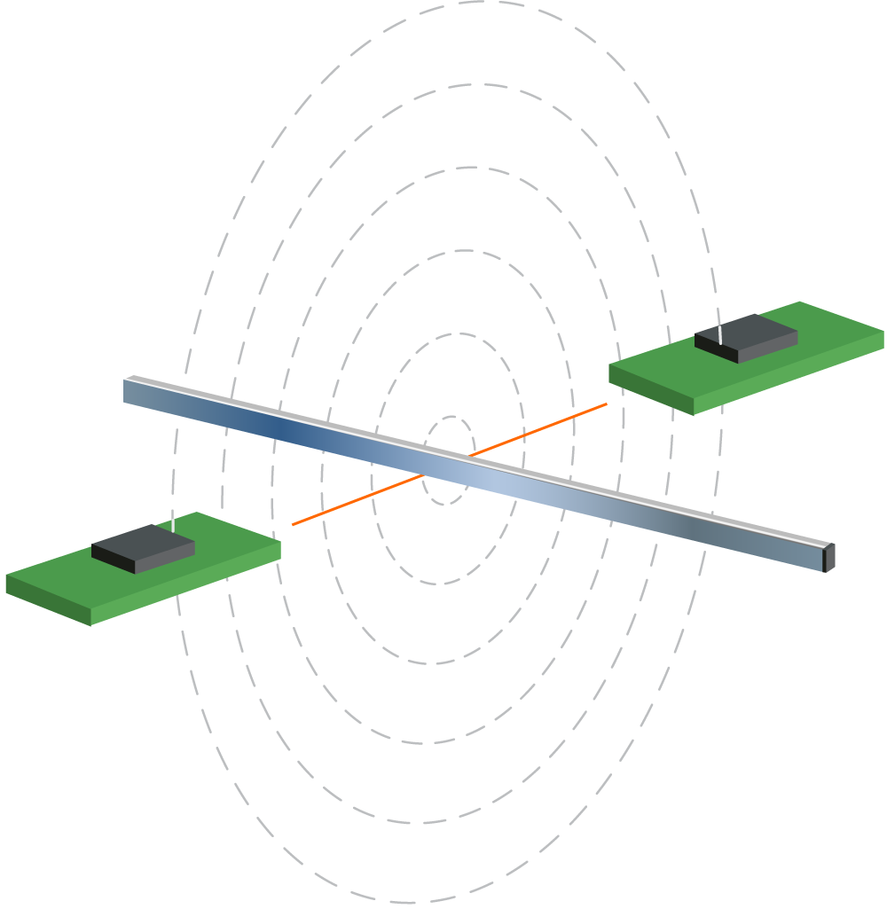
XtremeSense TMR is Less Sensitive to Stray Magnetic Fields
Robust Stray Field Immunity due to its axis of sensitivity.
10mm
10mm
At 10mm, XtremeSense TMR is only impacted by 2% of stray magnetic fields
Current flow

Slide 8
TMR Current Sensors

Slide 9

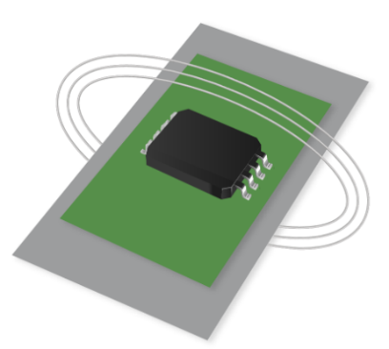
XtremeSense Current Sensors
Integrated Conductor (Contact)
Field Sensors (Contactless)
CT110
CT41x
CT42x
CT43x
CT100
CT220
CT45x

Slide 10
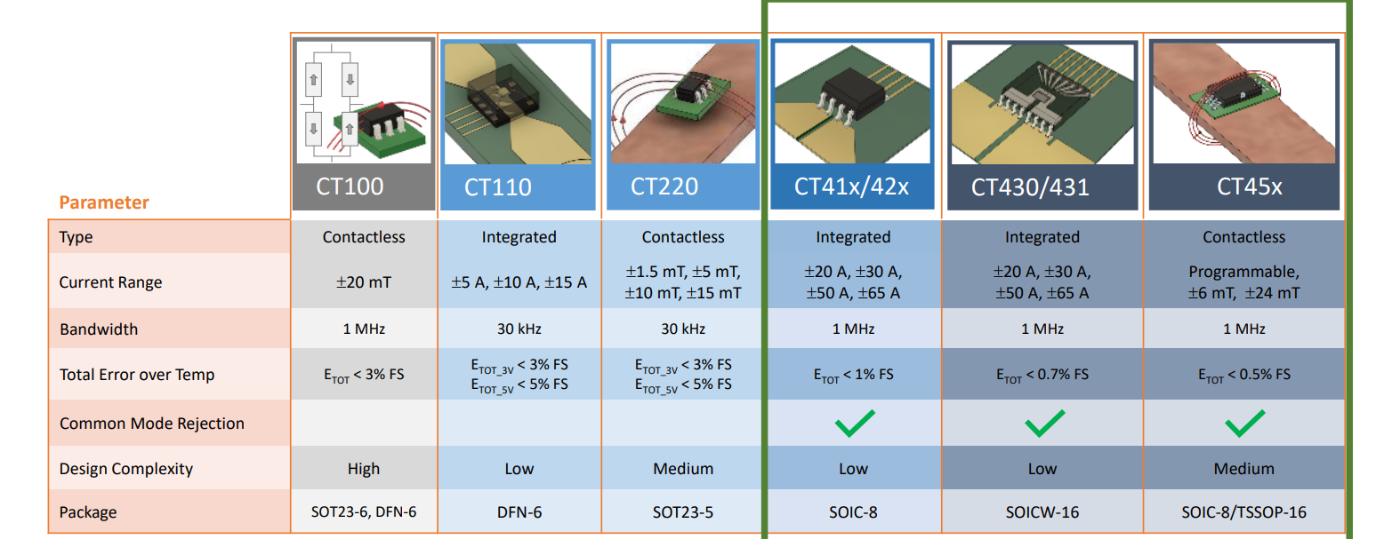
TMR Current Sensor Product Selection

Slide 11
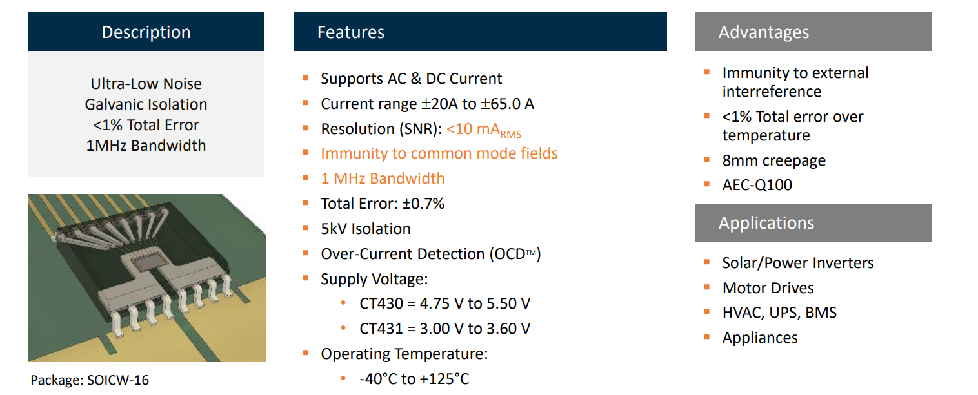
TMR Current Sensors – CT430 has super-hero performance

Slide 12
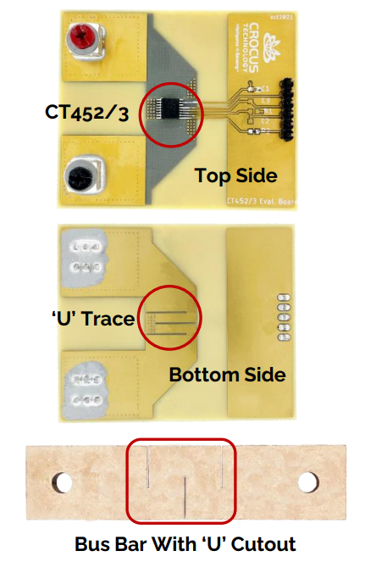
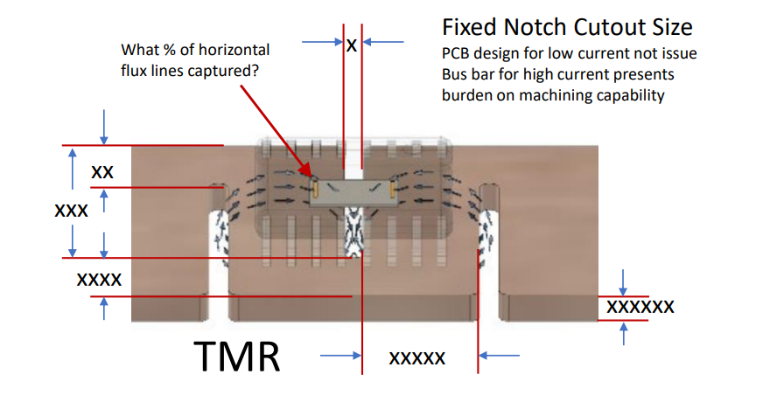
TMR Contactless Current Sensors – CT45x
Differential Common Mode Field Rejection

Slide 13
TMR Position Sensors

Slide 14
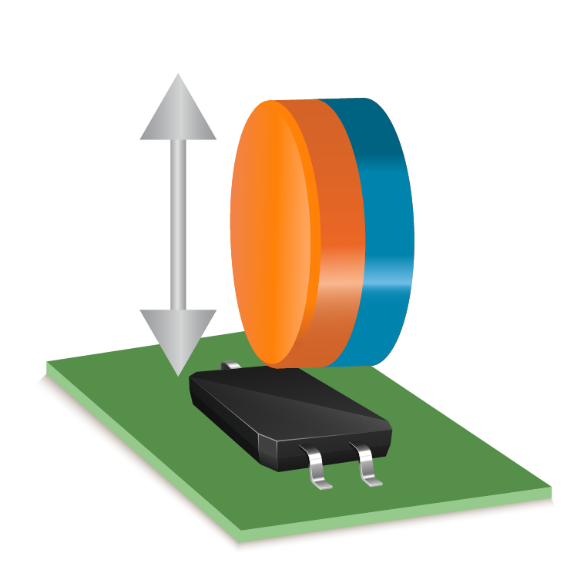
TMR Switches
Features
Switch
Low Power consumption 100nA
High Sensitivity and resolution
Small LGA package 1.5mm²
Product Selection Guide
Product Name | Polarity | Sensitivity Axis | Output Type
CT811x | Unipolar | X-axis | Push-pull & Open-drain
CT812x | Bipolar | X-axis
CT813x | Omnipolar | X-axis

Slide 15
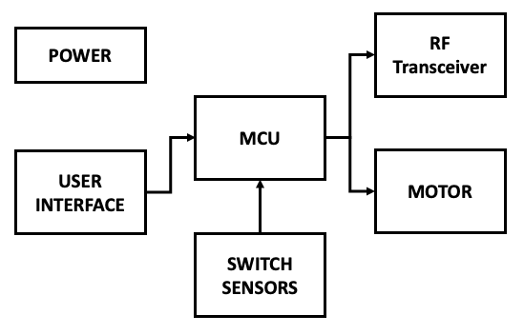
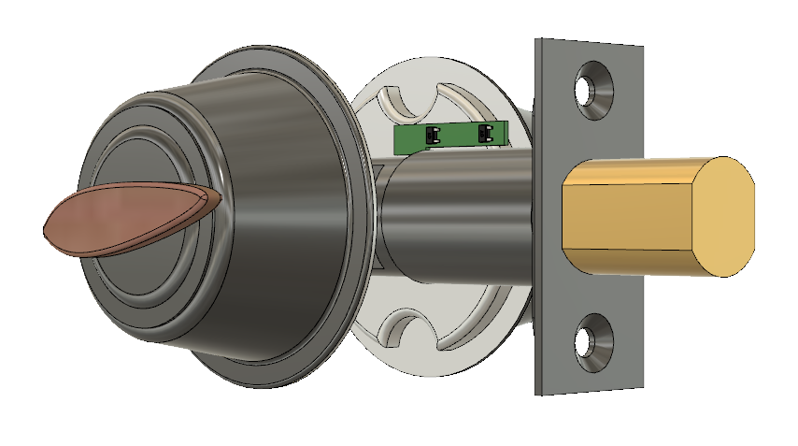
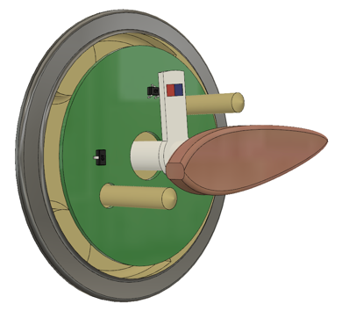
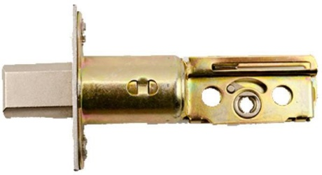



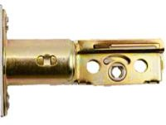
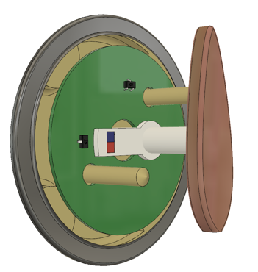


TMR SWITCH Sensors
Smart Door Lock
Benefits of Allegro XtremeSense TMR:
High Sensitivity for accurate dead bolt position detection
Long battery life with < 110 nA active current consumption
Digital output for easy interface
Cylinder knob implementation
Dead bolt implementation
N
S
Magnet
Omni-polar switch CT8132
Sensor
Magnet

Slide 16
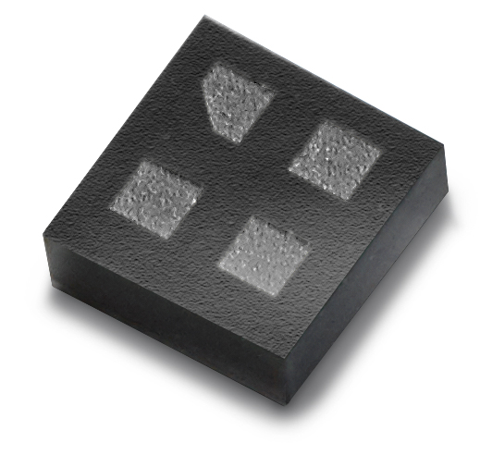
TMR SWITCH Sensors
Medical Devices
Benefits of Allegro XtremeSense TMR:
Small package size (LGA) for integration in disposables
Long battery life with < 110 nA active current consumption
TMR sensor can be used as wake-up device for other electronics (low active current)
Very high sensitivity allows for lower cost smaller magnets

Slide 17
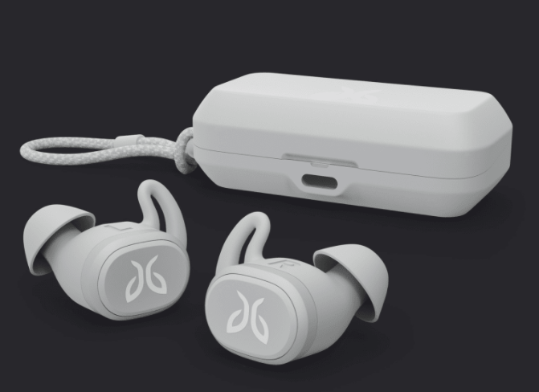
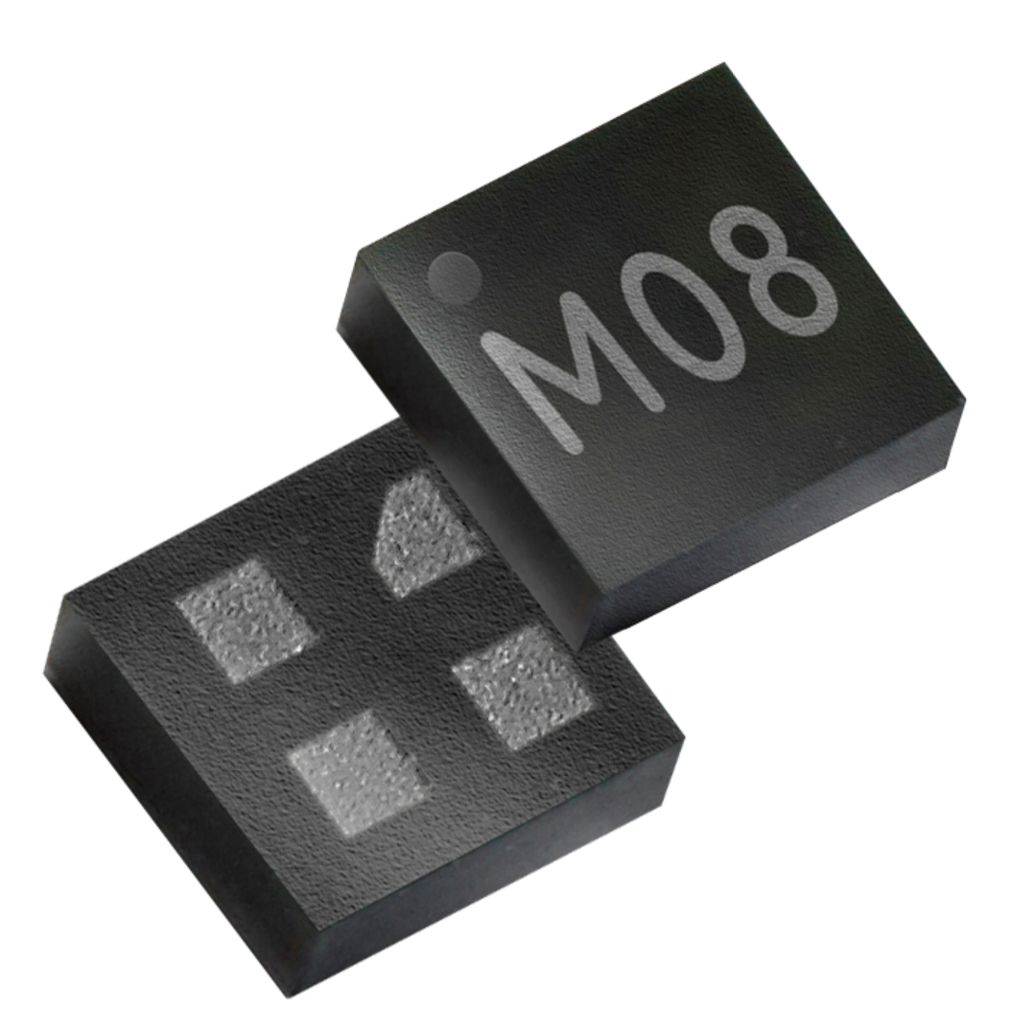
TMR SWITCH Sensors
Wireless Ear buds
Benefits of Allegro XtremeSense TMR:
Small package size (LGA) for integration in small personal electronics
Long battery life with < 110 nA active current consumption
TMR sensor used as open/close detect for charging
Very high sensitivity allows for lower cost smaller magnets

Slide 18
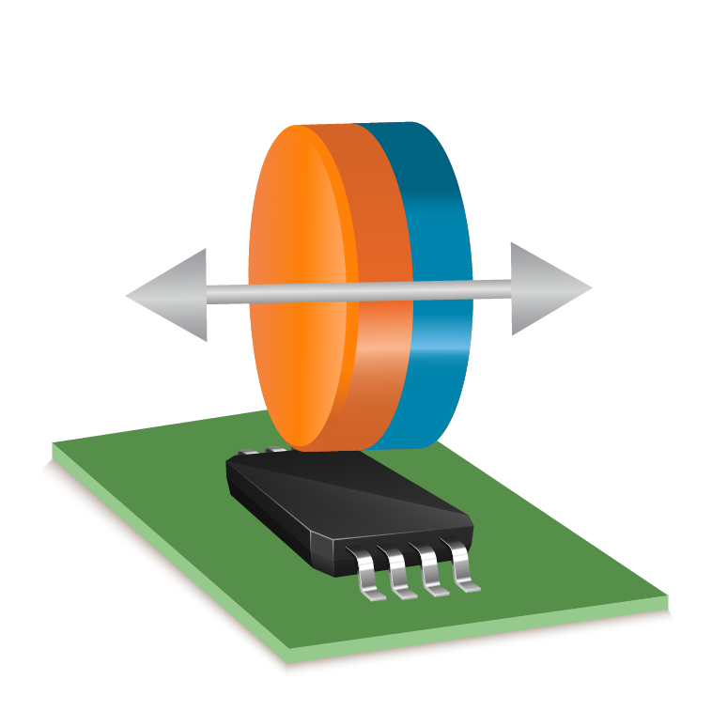
TMR Linear Sensors
Features
Linear
Low Power consumption < 1µA
High Sensitivity and resolution
Both planar and out-of-plane sensitivity axis
Product Selection Guide
Product Name | Sensitivity @ 3.3V | Sensitivity Axis | Output Type
CT100 | 12mV/mT | X-axis | Differential
CT130 | 2.5mV/mT | Z-axis | Differential
CT815x | 154mV/mT | X-axis | Single-ended
CT220 | 990mV/mT | X-axis | Single-ended

Slide 19
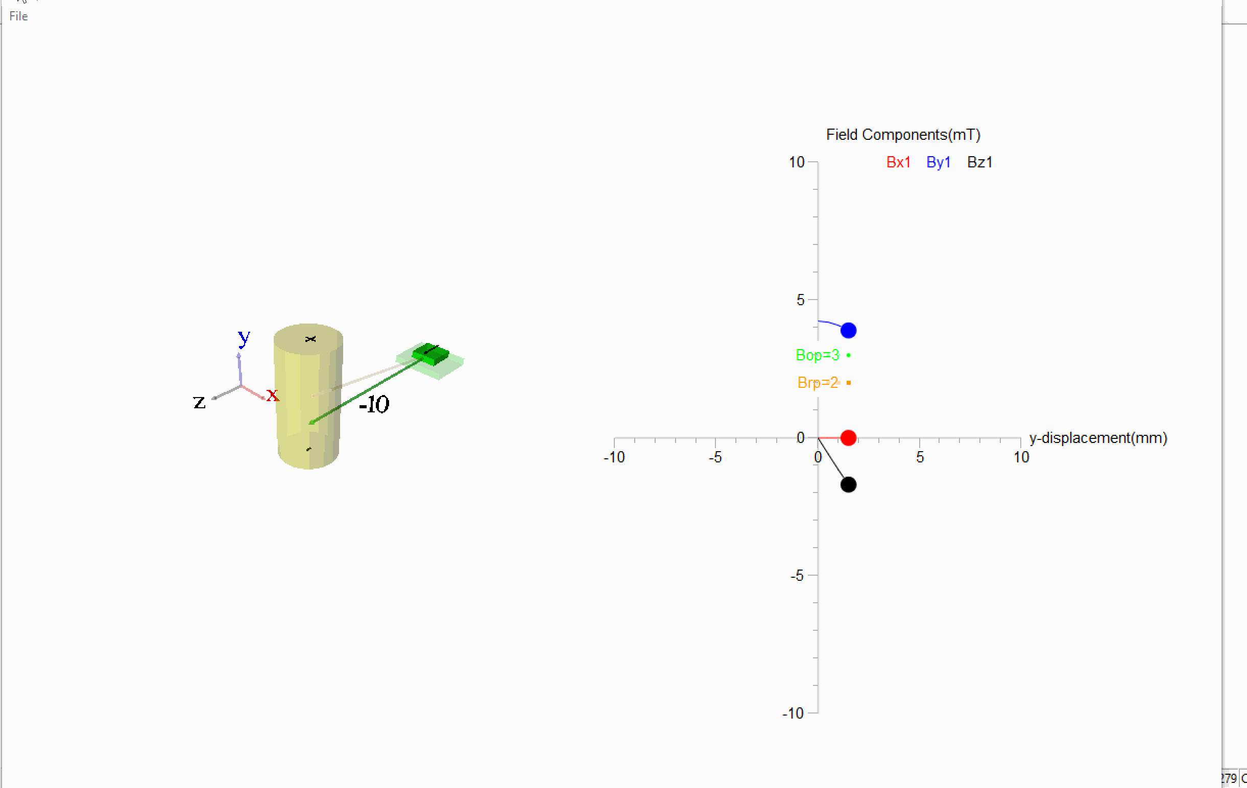
Linear Applications – Axis of sensitivity
Human Interface
- Game controller, triggers, sliders , joysticks
- Power Tools , triggers, dials, throttle
- Medical, pipettes, syringe, surgical instruments, catheters
- Audio, analog vibration sensing
- Video and Camera, image stabilization
- Wearables, shoe compression, gesture ID
TMR Sensor – parallel to PCB
Hall Sensor – normal to PCB
Machine Interface
- Magnetic Ruler, absolute position encoder
- DC motor, 3-phase position feedback
- Dynamic motion analysis, shock absorbers, table balance

Slide 20

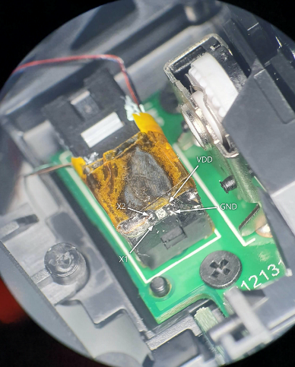
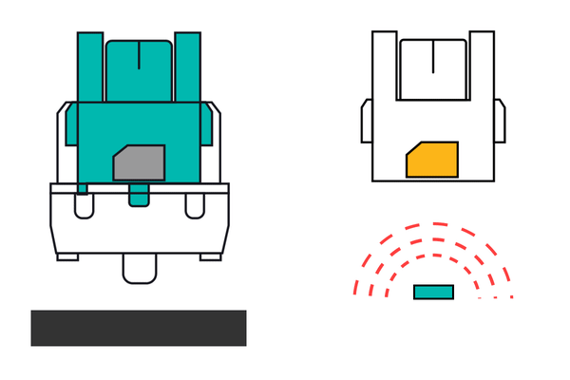
TMR Linear Sensors
Magnetic Keyboard
Benefits of Allegro XtremeSense TMR:
Faster Actuation
Adjustable Actuation point
  linear output
Faster Response time
More durability over mechanical or optical
Lower Power consumption compared to Capacitive or Hall Effect

Slide 21
TMR Angle Sensors
Features
Angle
Absolute Angular Error < 0.25°
Insensitive to airgap variation
Differential Analog outputs
Product Selection Guide
Product Name | Operating Range | Angular Error | Output Type
CT310 | 25mT – 90mT | 0.25° | Differential SIN and COS

Slide 22
TMR ANGLE Sensors
Industrial Motors
Benefits of Allegro XtremeSense TMR:
Angular error < 0.25 is ideal for precision motor position
Incremental plus absolute position
Insensitive to airgap variations
  Differential Analog outputs

Slide 23
Additional Information

Slide 24
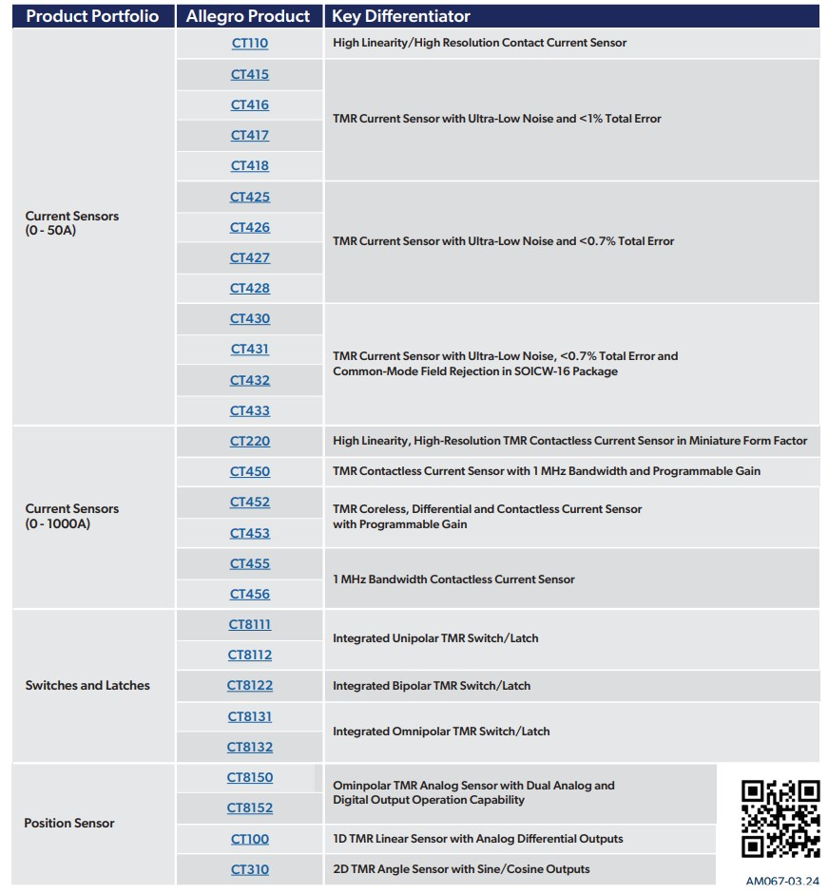
XtremeSense TMR: Product List

Slide 25

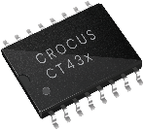

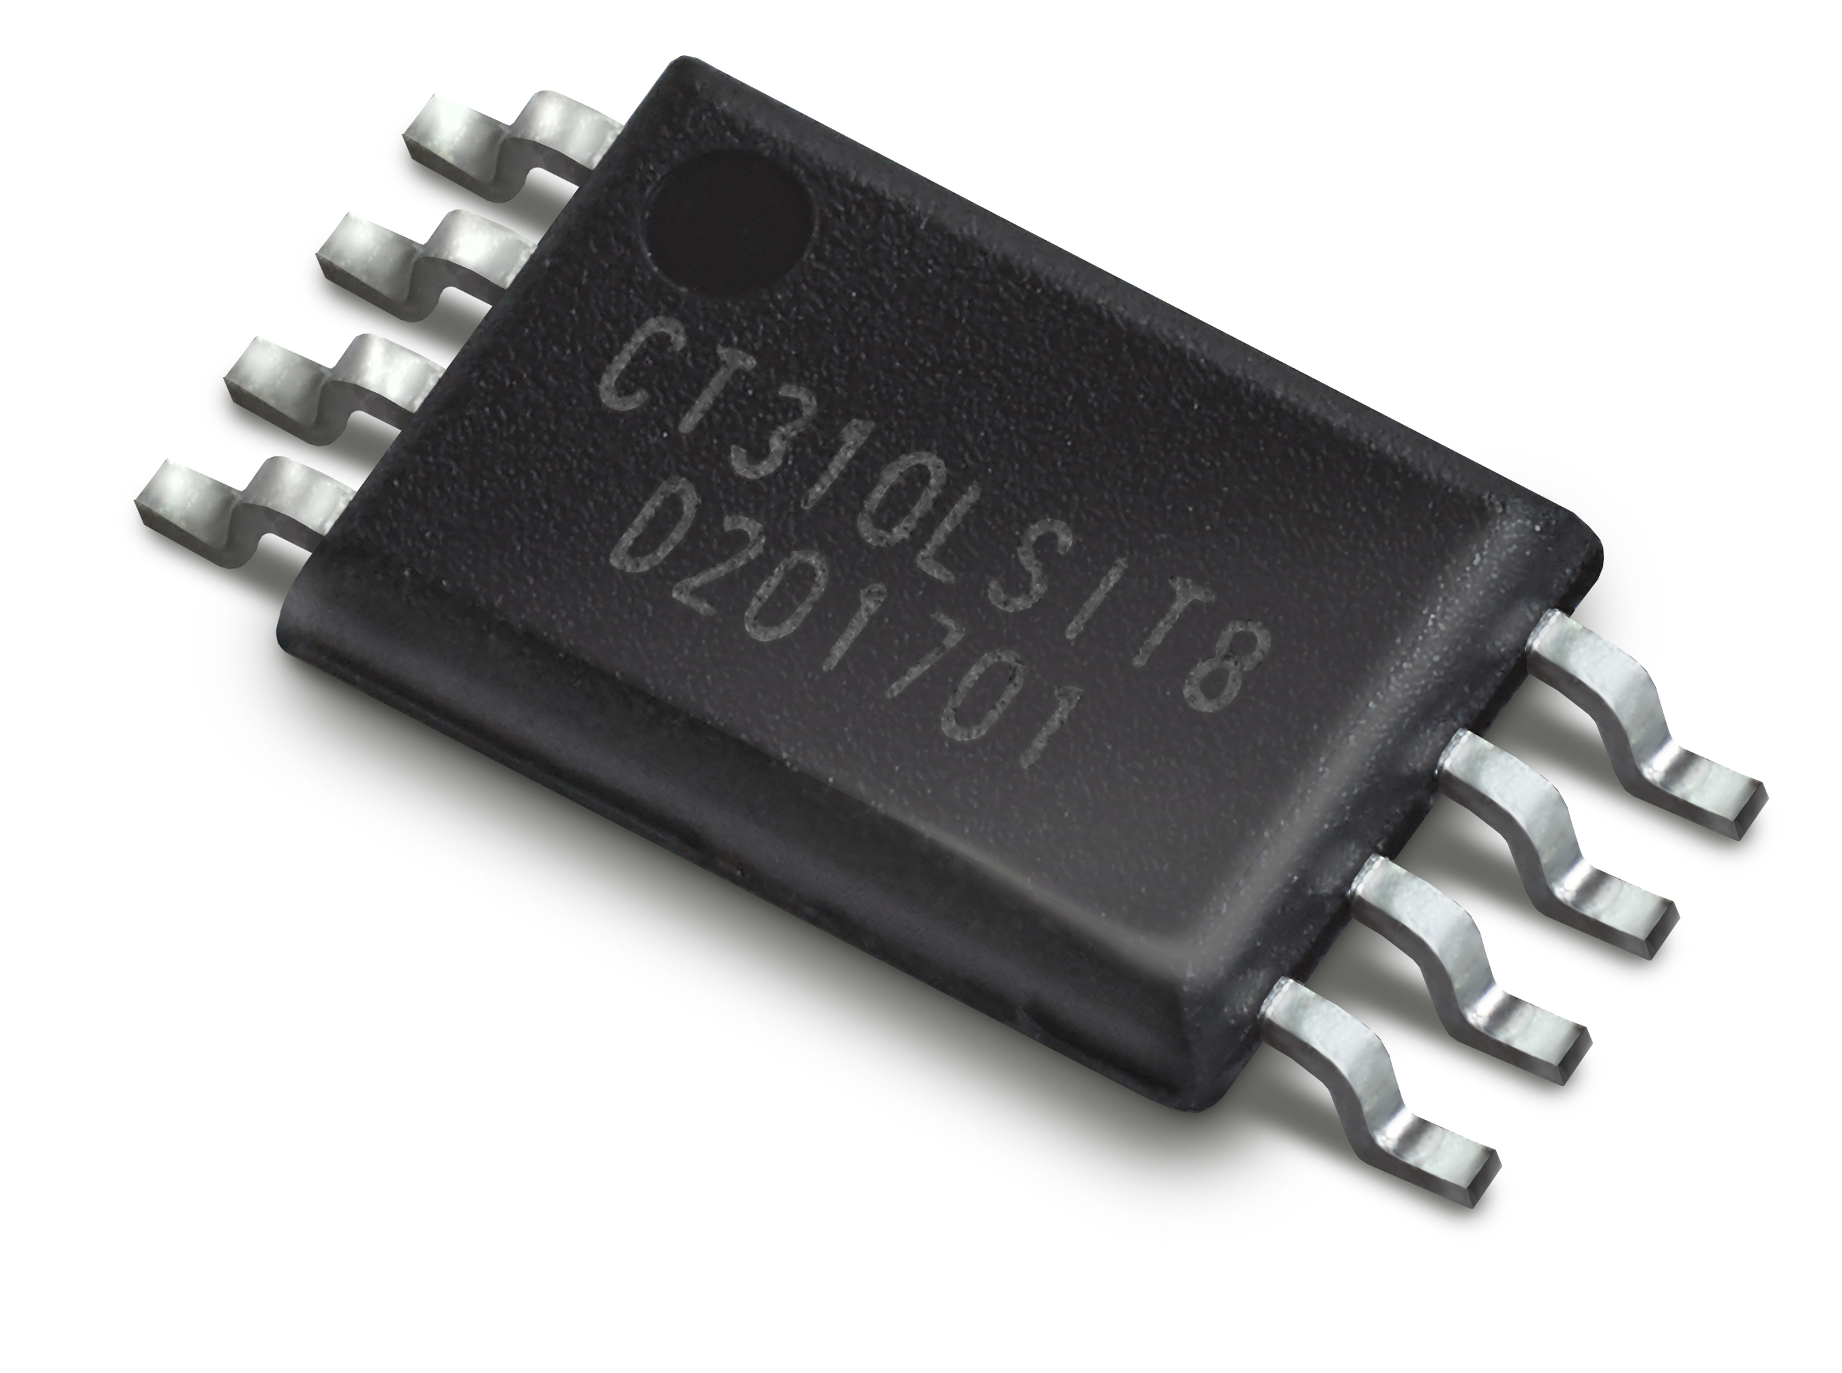
XtremeSense® TMR Sensors: Automotive Grade-1 Qualified
Integrated Current Sensor
PN | CT41x | CT42x | CT43x
AEC-Q100 Grade 1 | ✔️ | ✔️ | ✔️
Angle Sensor
PN | CT310
AEC-Q100 Grade 1 | ✔️

Slide 26
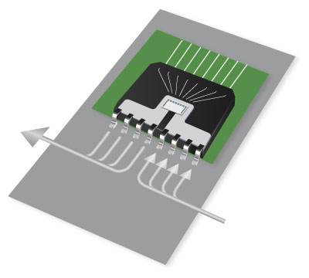
XtemeSense TMR Sensors and Target Applications
 | SENSOR
 | Current | Position | Application/Use case
xEV Powertrain | ◉ | ◉ | Current for OBC, DC-DC, Inverter, & PDU power conversion and SiC/GaN protection Position for motor position and battery disconnect unit
ADAS | ◉ | ◉ | Current for in-phase current sensing in EPS and EMB motors Position sensor for motor position, pedal and low power system wake up
Body Electronics |  | ◉ | Position for in-cabin motors, user interface, infotainment and HVAC systems
Clean Energy | ◉ | ◉ | Current for power conversion in solar, EV charging, and Energy Storage Position for EV plug and solar tracker
Data Centers | ◉ |  | Current for power conversion and protection in power supply units and server motherboards
Industrial | ◉ | ◉ | Current for in-phase current sensing in VFDs, Servo Drives, and E-Bikes Position sensors for motor commutation and motor position sensing
Consumer | ◉ | ◉ | Current sensor for fault monitoring and protection Very low power position sensor for battery operated personal, medical, gaming etc.
Current Sensors
Switch Latch
Linear Sensors
Angle Sensors

Slide 27
Thank You
Please visit allegromicro.com for more information

