Slide 1
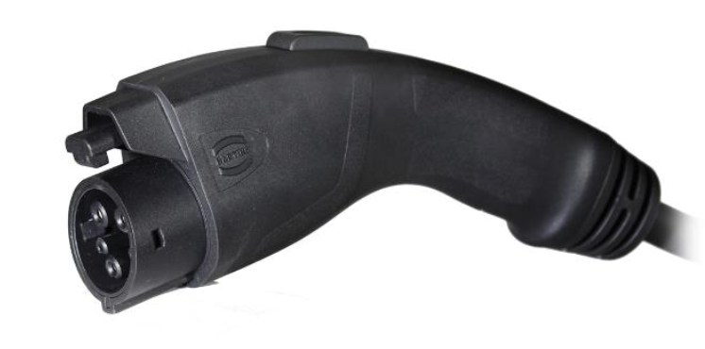
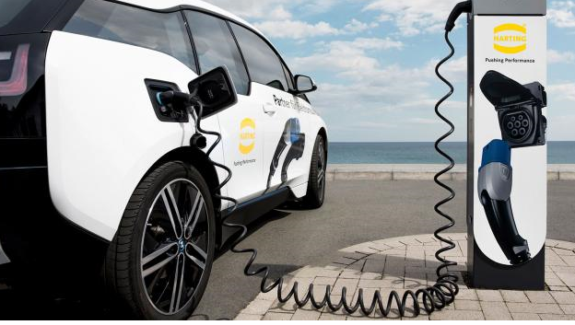
EV Charging Cables
Electric Vehicles need to charge, and standards were developed to define the interface between the EV and the charging infrastructure. The standard that is used in North America is SAE J1772, commonly referred to as Type-1. HARTING aims to sell these charging assemblies to Automotive OEMs and Charging Infrastructure OEMs.
https://www.harting.com/US/en/topics/electrical-vehicle-revolution-requires-reliable-charging
https://www.youtube.com/watch?v=JDzUvE7Pvxk
https://www.harting.com/sites/default/files/2022-10/2022-10-18_SG_emobility_interaktiv_EN_v2.pdf
Charging equipment for Electromobility | HARTING Technology Group
HARTING Type-1 Assembly
Technical Characteristics
  The HARTING Type-1 assembly is compatible with the SAE J1772 standard and manufactured out of Silao, Mexico
  Up to 80A
  Can add customer logo
  Flexible cable and terminations
Charging Stations
Key Trends/Needs in EV Charging
In-Region Manufacturing
The cost and duration of shipping assemblies from Asia is causing customers to look for North American manufacturing. HARTING also offers Buy America approved assemblies
APPLICATIONS
Quality
EV couplers will have to withstand a lot of abuse between weather conditions and lots of wear-and-tear
Rugged connectors are required
Portable Chargers
Increased Power
The industry is interested in lowering the time it takes to charge an EV. This requires higher power in the charging assembly, and new technology is being developed. HARTING is developing CCS1, bi-directional CCS1, liquid-cooled CCS1, and MCS and plans to offer in the near future

