Slide 1
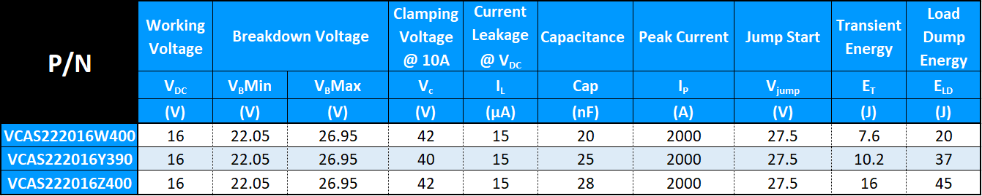
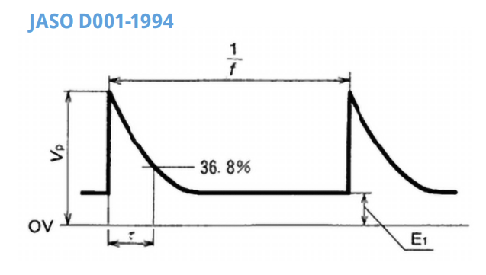
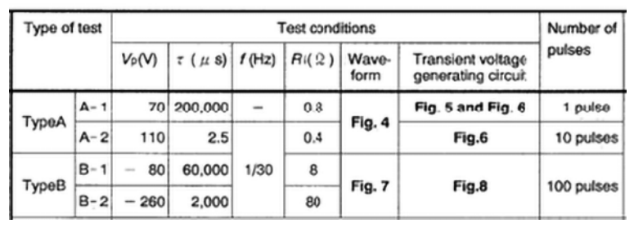
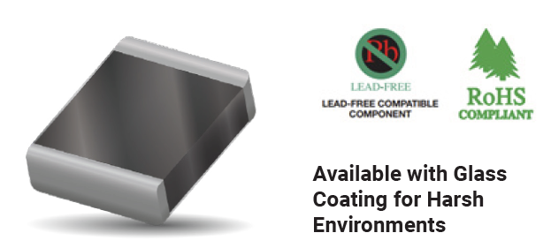
LOAD DUMP Varistor
ADVANTAGES
High Reliability
Fast Response
High Energy Absorption
High Current Handling
No Temperature Derating
EMI/ RFI Attenuation
Smaller Footprint
Bi-directions
Lighter Weight
JASO D001 1994
AEC-Q200 Qualified
ISO-16750-2:2010

