Slide 1
XLamp XP-G2 High Efficacy LEDs

Slide 2
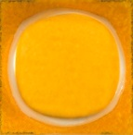
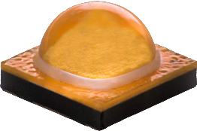
XLamp XP-G2 High Efficacy LEDs
XLamp XP-G2 White
High Efficacy
Footprint: | 3.45 mm x 3.45 mm
Max Current: | 2000 mA
Natural Upgrade Path for XP-G2 Designs
Better Price-Performance Roadmap
Better Vf vs. Current and Temperature than XP-G2
Alternative to XP-G3 & XT-E LEDs with less color separation
Leveraging Dmax chip technology
Optically and mechanically compatible in most systems
Similar flux as XP-G2

Slide 3
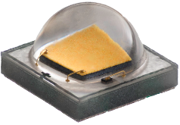
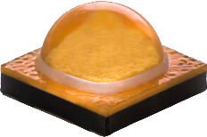
Characteristics: XP-G2 vs XP-G2 HE
 | XP-G2 | XP-G2 High Efficacy
Max Current | 1500 mA | 2000 mA
Typical Vf (350 mA, Tj = 85°C) | 2.80 V | 2.73 V
Max Vf (350 mA, Tj = 85°C) | 3.15 V | 3.00 V
Thermal Resistance | 4 °C/W | 3 °C/W

Slide 4
XLamp XP-G2 HE Improves LPW by 4%
XP-G2 HE
Flux Bin | LPW
S4 (164 lm) | 153
S3 (156 lm) | 146
XP-G2
Flux Bin | LPW
S4 (164 lm) | 148
S3 (156 lm) | 140
Min flux, typical Vf @ 700 mA, Tj = 85°C

Slide 5
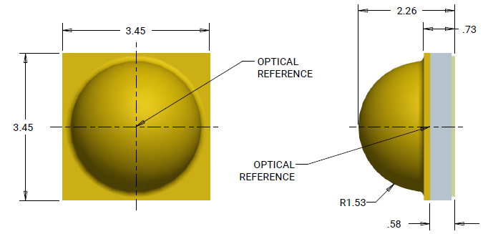

XLamp XP-G2 High Efficacy Characteristics & Features
 | XP-G2 HE
Max Current / Power | 2000 mA / 6W
Typ. Vf @ 350 mA, 85°C | 2.73 V
Viewing Angle | 125º
Thermal Resistance | 3 ºC/W
Reflow Solderable | Yes
RoHS & REACH | Yes
UL Recognized | Level 4
Elec. Neutral Thermal Pad | Yes
CRI | >5000K | 5000K | 4500K | 4000K | 3500K | 3000K | 2700K
70 min
80 min
90 min

Slide 6
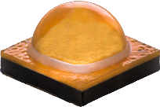
XLamp XP-G2 High Efficacy Standard Order Codes
For a complete listing of available order codes, refer to the data sheet
Min Flux (350 mA, 85 ºC) | >5000K (51) | 5000K (E3) | 4000K (E5) | 3500K (E6) | 3000K (E7) | 2700K (E8) | Flux (350 mA, 25 ºC) | Flux (700 mA, 85 ºC) | Flux (1.5 A, 85 ºC)
S4 (L) | 164 | 164 | 164 | 164 |  |  | 180 | 303 | 561
S3 (K) | 156 | 156 | 156 | 156 | 156 | 156 | 171 | 288 | 534
S2 (J) | 148 | 148 | 148 | 148 | 148 | 148 | 163 | 273 | 506
R5 (H) | 139 | 139 | 139 | 139 | 139 | 139 | 153 | 257 | 475
R4 (G) | 130 | 130 | 130 | 130 | 130 | 130 | 143 | 240 | 445
R3 (F) |  | 122 | 122 | 122 | 122 | 122 | 134 | 225 | 417
R2 (E) | 114 | 114 | 114 | 114 | 114 | 114 | 125 | 210 | 390
Q5 (D) | 107 | 107 | 107 | 107 | 107 | 107 | 118 | 197 | 366
Minimum luminous flux @ 350 mA, 85 °C (lm)
70 CRI min (B)
80 CRI min (H)
90 CRI min (U)
XP-G2 High Efficacy | XPGBWT-HE-0000-00HE7
 |  | CRI Flux Color

