Slide 1
XLamp XP-E2 Photo Red & Far Red LEDs

Slide 2
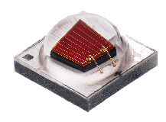
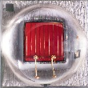
XLamp XP-E2 Photo Red & Far Red LEDs
XLamp XP-E2
Photo & Far Red
Footprint: | 3.45 mm x 3.45 mm
Max Current: | 1000 mA
Best-in-Class Output & Efficiency
Easy Upgrade Path
Drop-in compatible with existing XP-based designs
Up to 57% higher minimum flux output
Only LEDs with >3.2 μmol/J PPE at both 660 & 730 nm
Up to 68% higher efficiency than competing LEDs
Breakthrough Performance Over Previous Generation
Lower Vf for improved efficiency
Enables 3.0 μmol/J full spectrum (W+R) designs
Same mechanical and optical characteristics as previous generation

Slide 3
XLamp XP-E2: Breakthrough Performance vs Previous Generation
+6-21% min flux
+40-57% min flux
Min. Flux Bin | Photo Red (660 nm)
 | XP-E HE | XP-E2
30 |  | 450 mW
29 | 425 mW | 425 mW
28 | 400 mW
27 | 375 mW
26 | 350 mW
Min. Flux Bin | Far Red (730 nm)
 | XP-E | XP-E2
26 |  | 350 mW
25 |  | 325 mW
24 |  | 300 mW
23 |  | 275 mW
12 | 250 mW
11 | 210 mW
10 | 175 mW
Minimum radiant flux @ 350 mA, 25°C (mW)
Minimum radiant flux @ 350 mA, 25°C (mW)

Slide 4
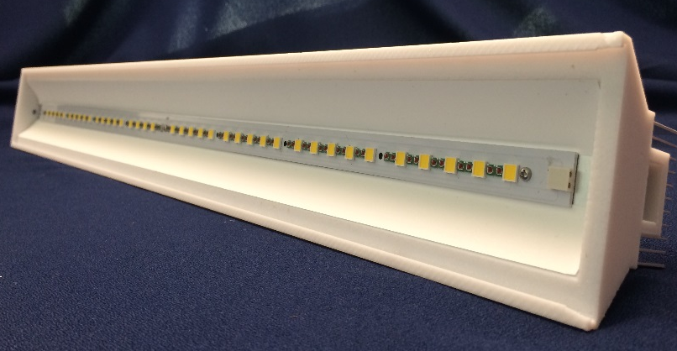


Reference Design: Vertical Farming (W+R) Full Spectrum Linear
LEDs (Count) | (80) XLamp XP-E2 Photo Red (40) XLamp MHB-B White
Output Mode | Low | Medium | High
PPF (μmol / s) | 166.7 | 226.7 | 340.3
PPF/W (μmol / J) * | 3.06 | 2.89 | 2.64
Power | 54.5 W | 78.4 W | 128.9 W
Tsp | 45°C | 65°C | 85°C
White LED Current | 87.5 mA | 125 mA | 200 mA
Red LED Current | 175 mA | 250 mA | 400 mA
Dimensions (LWH) | 24” x 2.5” x 3” (60.9 x 6.4 x 7.6 cm)
Weight | 2 lbs (0.91 kg)
Best full spectrum performance: up to 3.06 PPF/W
Passively cooled design
Thin profile, lightweight
* Note: PPF/W excludes driver losses

Slide 5
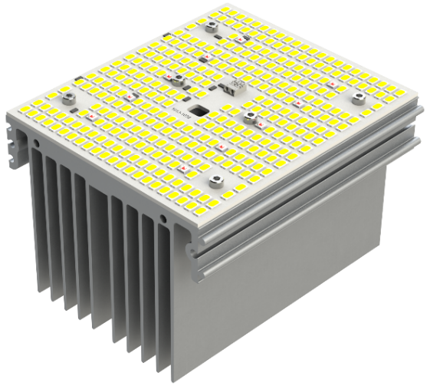
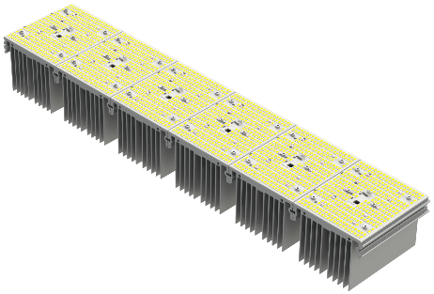

Reference Design: Greenhouse (W+R) Building Block
LEDs (Count) | (320) J Series 5630 HE (10) XLamp XP-E2 Photo Red
Output Mode | Low | Medium | High
PPF (μmol / s) | 137 | 262 | 373
BPF (μmol / s) | 141 | 269 | 383
PPF/W (μmol / J) * | 2.94 | 2.74 | 2.54
Power | 47 W | 96 W | 147 W
Tsp | 40°C | 60°C | 85°C
Current – 5630 Current – XP-E2 PR | 50 mA 200 mA | 100 mA 400 mA | 150 mA 600 mA
Dimensions (LWH) | 5” x 26.22” x 3.25” (13 x 67 x 8.3 cm)
Weight | 12 lbs (5.4 kg)
Meets the DLC Horticulture requirements
Smaller footprint to prevent shadowing
Provides supplemental spectrum and energy in a modular building block
* Note: PPF/W excludes driver losses

Slide 6
Competitor Comparison: 660 nm Red
Cree delivers industry’s highest min PPF, up to 37% higher than others
LED | Typ Vf | Typ Flux (mW) | Typ PPF (μmol/s) | Typ PPE (μmol/J) | Min Flux (mW) | Min PPF (μmol/s) | PPE @ Min (μmol/J)
XLamp XP-E2 | 2.05 V | >450 | >2.44 | >3.41 | 450 | 2.44 | 3.41
OSRAM OSLON SSL (1.24) | 2.05 V | 425 | 2.31 | 3.22 | 400 | 2.17 | 3.03
Lumileds SunPlus 20 | 2.09 V | 372 | 2.02 | 2.76 | 327 | 1.78 | 2.43
Lumileds SunPlus 20 G2 (prelim) | 2.15 V | 442 | 2.40 | 3.19 | 327 | 1.78 | 2.43
Samsung LH351H | 2.10 V | 425 | 2.31 | 3.14 | 390 | 2.12 | 2.88
SSC SZDR5A0B | 2.10 V | 410 | 2.23 | 3.03 | 360 | 1.95 | 2.66
Performance values @ 350 mA, Tj = 25°C
Values in italics were calculated using factor 0.00543 μmol/s / mW
PPE @ Min = PPE calculated with min PPF & typical Vf

Slide 7
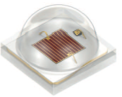

XLamp XP-E2 Photo Red Delivers Leading PPE
XLamp XP-E2 delivers ~75% the PPF of OSLON Square at same PPE
OSRAM OSLON Square
GH CSSRM2.24
VM bin (best min available)
XLamp XP-E2
XPEBPR
450 mW bin (best min available)
Current (A) | Flux (mW) | PPF (μmol/s) | Vf (V) | PPE (μmol/J) | Current (A) | Flux (mW) | PPF (μmol/s) | Vf (V) | PPE (μmol/J)
0.350 | 405 | 2.20 | 1.94 | 3.24 | 0.250 | 282 | 1.53 | 1.88 | 3.25
0.500 | 573 | 3.11 | 2.02 | 3.08 | 0.400 | 451 | 2.45 | 1.99 | 3.08
0.700 | 799 | 4.34 | 2.11 | 2.94 | 0.530 | 597 | 3.24 | 2.08 | 2.94
1.53/2.20 = 70%
2.45/3.11 = 79%
3.24/4.34 = 75%
Performance values @ Tj = 85°C
Values in italics were calculated using factor 0.00543 μmol/s / mW

Slide 8
Competitor Comparison: 730 nm Red
Cree delivers industry’s highest min PPE, up to 68% higher than others
LED | Typ Vf | Typ Flux (mW) | Typ PPF* (μmol/s) | Typ PPE (μmol/J) | Min Flux (mW) | Min PPF* (μmol/s) | PPE @ Min (μmol/J)
XLamp XP-E2 | 1.85 V | >325 | >1.95 | >3.01 | 350 | 2.10 | 3.24
OSRAM OSLON SSL (1.24) | 1.95 V | 317 | 1.90 | 2.79 | 250 | 1.50 | 2.20
Lumileds SunPlus 20 | 1.83 V | 260 | 1.56 | 2.44 | 209 | 1.25 | 1.96
Lumileds SunPlus 20 G2 (prelim) | 1.95 V | 330 | 1.98 | 3.09 | 209 | 1.25 | 1.96
Samsung LH351H | 1.90 V | 330 | 1.98 | 2.98 | 280 | 1.68 | 2.53
SSC SZFR5A0B | 1.90 V | 317 | 1.90 | 2.86 | 280 | 1.68 | 2.53
Performance values @ 350 mA, Tj = 25°C
PPF range shown for 300-800 nm; values in italics were calculated using factor 0.006 μmol/s / mW
For reference, PPF_{FR} (700-800 nm) values can be calculated with factor 0.0056 μmol/s / mW
PPE @ Min = PPE calculated with min PPF & typical Vf

Slide 9
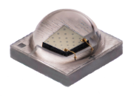
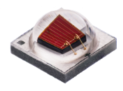
XLamp XP-E2 Color: Available Order Codes
Color | Royal Blue | Blue | Green | Amber | PC Amber | Red-Orange | Red | Photo Red | Far Red
DWL (nm) | 450-465 | 465-485 | 520-535 | 585-595 |  | 610-620 | 620-630 | 650-670 | 720-740
Flux Unit | mW | lm | lm | lm | lm | lm | lm | mW | mW
Available Min Flux Bins | 650 625 600 | 45.7 39.8 35.2 | 130 122 114 | 87.4 80.6 73.9 | 107 100 93.9 | 107 100 93.9 | 80.6 73.9 67.2 | 450 425 | 350 325 300
Minimum flux @ 350 mA, 25°C

