Slide 1
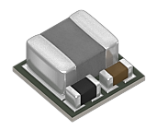
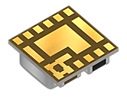
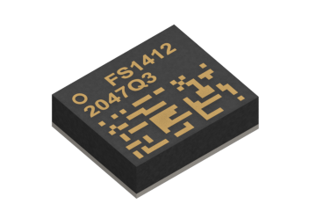
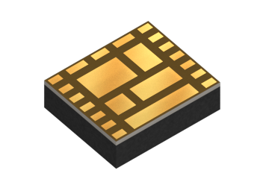
µPOL Selection Guide
(*) MOQ reels
“-AS” small reel 250units
“-AL” large reel 3.9k/4k units
SERIES |  | FS1703 | FS1403 | FS1404 |  | FS1406 |  | FS1412 | FS1412
Illustrations
Package |  | LGA / 17PIN |  |  |  |  |  | LGA / 22PIN
Dimensions |  | 3.3mm × 3.3mm × 1.5mm |  |  |  |  |  | 4.9mm × 5.8mm × 1.6mm
Output Current (I_{out}) |  | 3A |  | 4A |  | 6A |  | 12A | 12A
Input Voltage (V_{in}) |  | 5V | 8V to 16V | 4.5V to 16V | 6V to 16V | 4.5V to 16V (check operating condition vs. Vout)
Output Voltage V_{out} | 5.00 |  | FS1403-5000-*
 | 3.30 | FS1703-3300-* | FS1403-3300-* |  | FS1404-3300-*
 | 2.64 |  |  |  |  | FS1406-2640-*
 | 2.50 |  |  | FS1404-2500-* |  | FS1406-2500-*
 | 1.80 |  |  |  |  | FS1406-1800-* | FS1406-0600-* | FS1412-0600-* | FS1412-0600-*
 | 1.20 |  |  |  |  | FS1406-1200-*
 | 1.10 |  |  |  |  | FS1406-1100-*
 | 1.05 |  |  |  |  | FS1406-1050-*
 | 1.00 |  |  |  |  | FS1406-1000-*
 | 0.90 |  |  |  |  | FS1406-0900-*
 | 0.80 |  |  |  |  | FS1406-0800-*
 | 0.75 |  |  |  |  | FS1406-0750-*
 | 0.70 |  |  |  |  | FS1406-0700-*
 | 0.60
Evaluation Board |  | EV1703-3300-AEV | EV1403-5000-A | EV1404-3300-A |  | EV1406-1800-A / EV1406-0600-A |  | EV1412-0600-A | EV1412-0600-A
Operating Temperature |  | -40ºC to 125ºC
Mode of Control |  | ANALOG
 |  |  | I²C |  |  | I2C
 |  |  |  |  |  |  |  | PMBus

